Slide 2
BI MINI PROJECT WORLD POPULATION ANALYSIS
G.VINEETH
161158

Slide 3
Problem Statement
Problem Statement
Objective
Development of a WORLD POPULATION ANALYSIS System
Abstract of the project
This Document on world population projects the population count of all countries of the
world from 1950 to 2014.It also categorises the countries as continent wise, governance wise, development wise.
Technology used:
Oracle 9i (Database)
Informatica power center 9.5.1 (ETL Tool):-
BusinessObjects XI Release 4

Slide 4
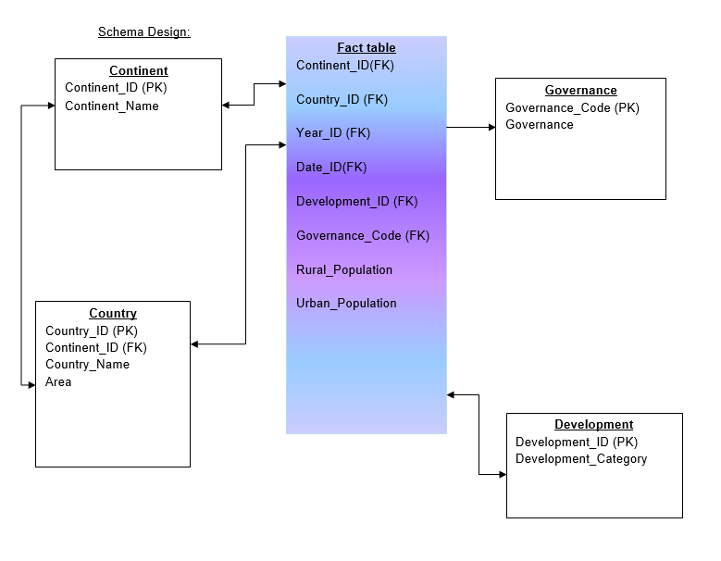
SCHEMA DESIGN

Slide 5
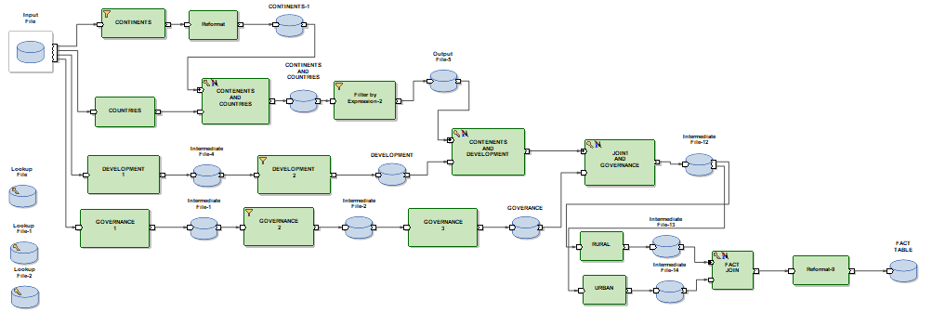
FACT TABLE

Slide 6
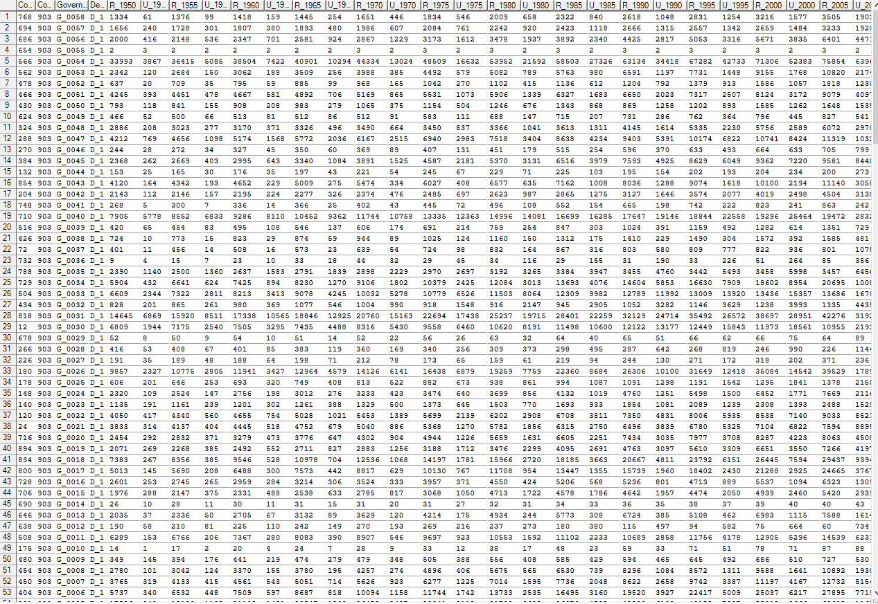

Slide 7
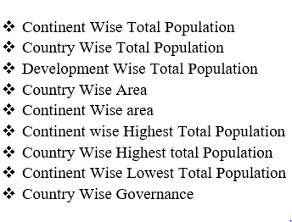
SAMPLE REPORTS

Slide 8
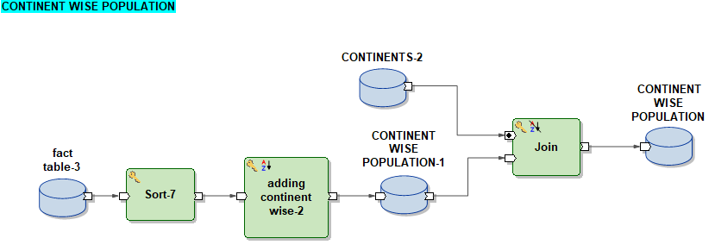
CONTINENT WISE POPULATION

Slide 9
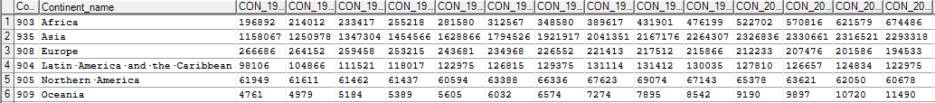

Slide 10
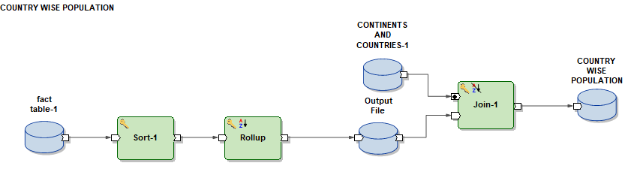
COUNTRY WISE POPULATION

Slide 11
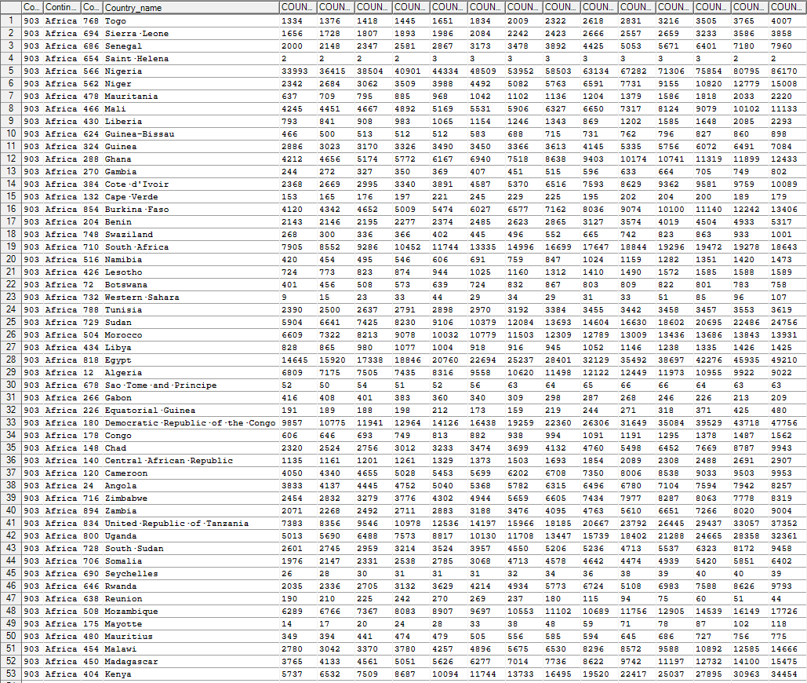

Slide 12
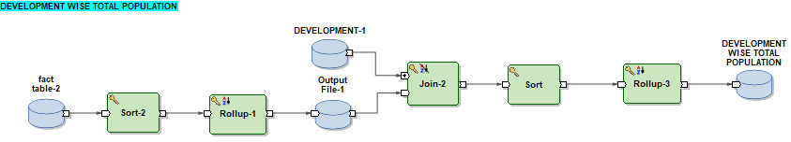
DEVELOPMENT WISE TOTAL POPULATION

Slide 14
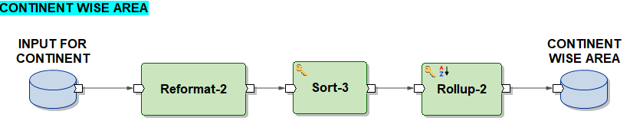
CONTINENT WISE AREA

Slide 15
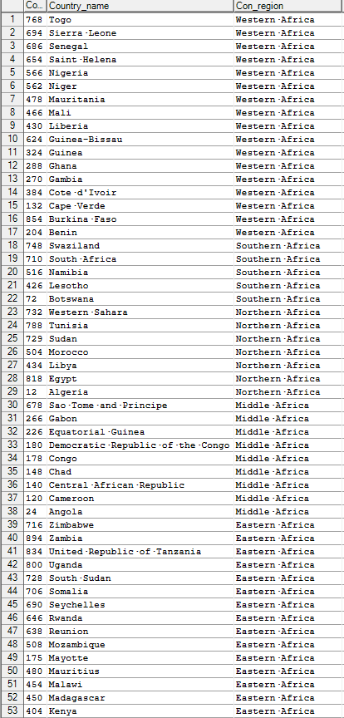

Slide 16
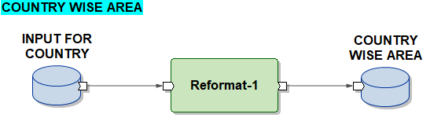
COUNTRY WISE AREA

Slide 17
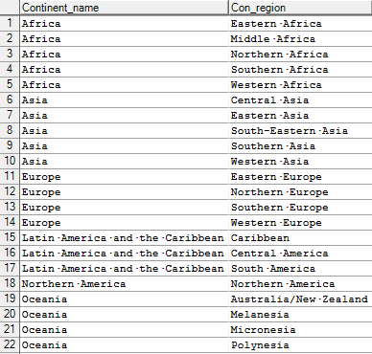

Slide 18
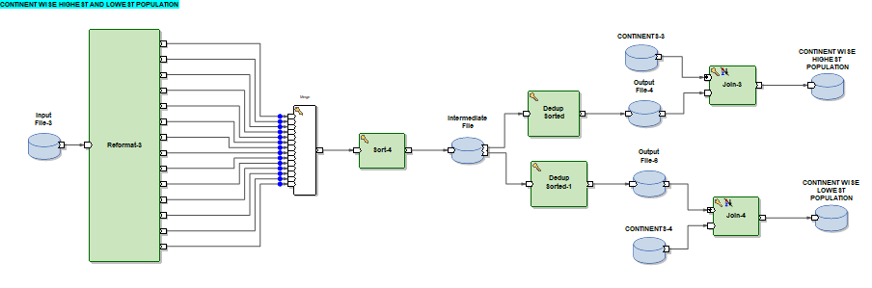
CONTINENT WISE HIGHEST AND LOWEST POPULATION

Slide 19
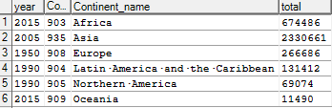

Slide 20
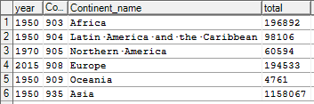

Slide 21
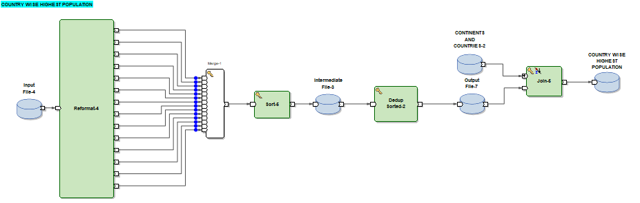
COUNTRY WISE HIGHEST POPULATION

Slide 22
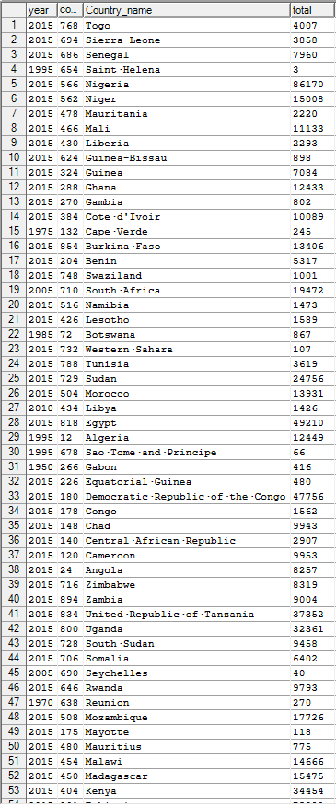

Slide 23
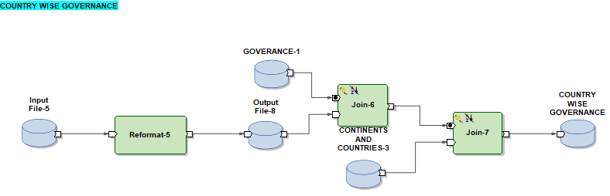
COUNTRY WISE GOVERNANCE

Slide 24
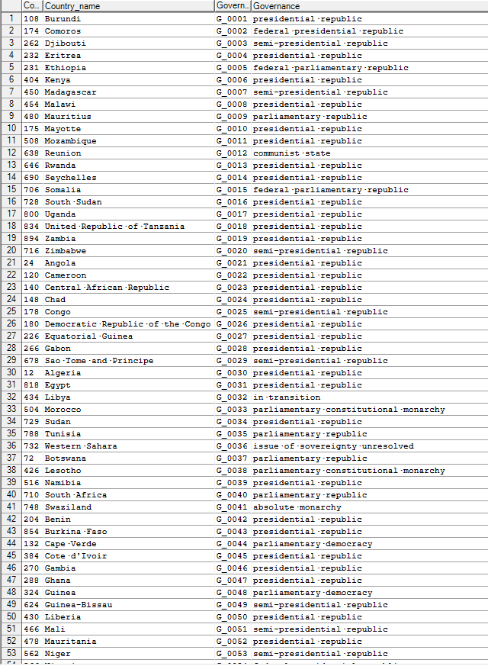

Slide 25
THANK YOU…

